Slide 1

UP AND DOWN: HOW TALL ARE YOU REALLY? BY SONY MARTIN

Slide 2

VERY PERI
Do you remember when you had relatives who were once taller than you and one day
It seemed as if they had shrunken? It is because they shrunk. Not all at once but
Over a period of time, this does occur. Below is a sample of such.
Introducing the Pantone Color of the Year 2022. PANTONE 17-3938 Very Peri is a dynamic hue that blends the faithfulness and constancy of blue with the energy and excitement of red.
The four color palettes in this template feature Very Peri to help you express your ideas and convey the right mood. Read on to learn how to use these colors in any presentation.

Slide 3








WELLSPRING

Slide 4
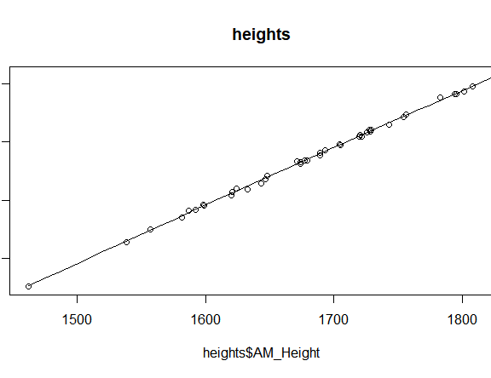
LINEARITY TEST IN R
Testing for the first assumption, linearity, so far looks good. All the point are in a line and that is what you want. On to the second test

Slide 5







THE STAR OF THE SHOW

Slide 6

Test for homoscedasticity
These plots show where the data lies. Below are the results of the first plot test. The top left and bottom left graphs have straight lines for the most part but on the bottom left graph there is a slight bend in the line. So before declaring
homoscedasticity to be true I will do one more test. I chose to do a Breush – Pagan test results of which are shown below.

Slide 7
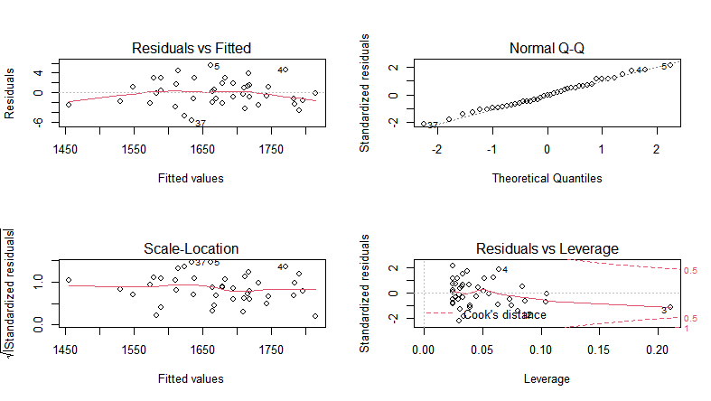

Slide 8

Breush – Pagan results
studentized Breusch-Pagan test
data: htsMod
BP = 0.2079, df = 1, p-value = 0.6484 the p- value number is far above 0.05, so as indicated in the plots above this has failed homoscedascity and is showing heteroscadasticity instead. For purposes of finishing the lesson we will try to correct this .

Slide 9


Box cox transformation
The purpose of the box cox transformation is to try to make the dependent variable, in this case the PM heights more normal so that the assumption of homoscedasticity, or the straight line you want to see comes up. This involves adding the changes that come up to the end of the model then making a new model and re re running the Breusch – P agan test to see if the heteroscadiscity has been corrected.

Slide 10
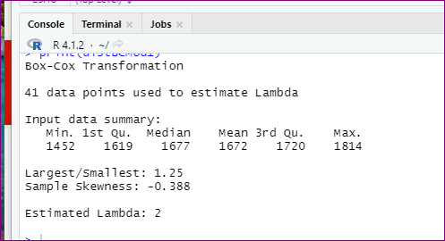

Slide 11

Still no go…….
Studententized Breusch-Pagan test
Data: lmMod_bc2
BP= 1.7, df =1, p-value = 0.1923
Still with me? Ok. What this means in a nutshell:
The p- value is still very significant, therefore after all that has been done the assumption of homoscedasticity has still failed. Shaq missed a few free throws once in a while too. So I will still run a test for outliers, just because I need the practice. I am however only going to run one.

Slide 12
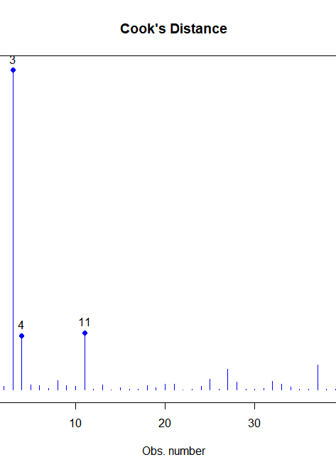
Outliers they are out there
These are the outliers that are in the x space. It is safe to assume they have had a hand in the hetereoscadiscity –ness.
There are other outlier tests but for purposes of finishing my lesson, I will actually do those in the python portion of the hands on.

Slide 13
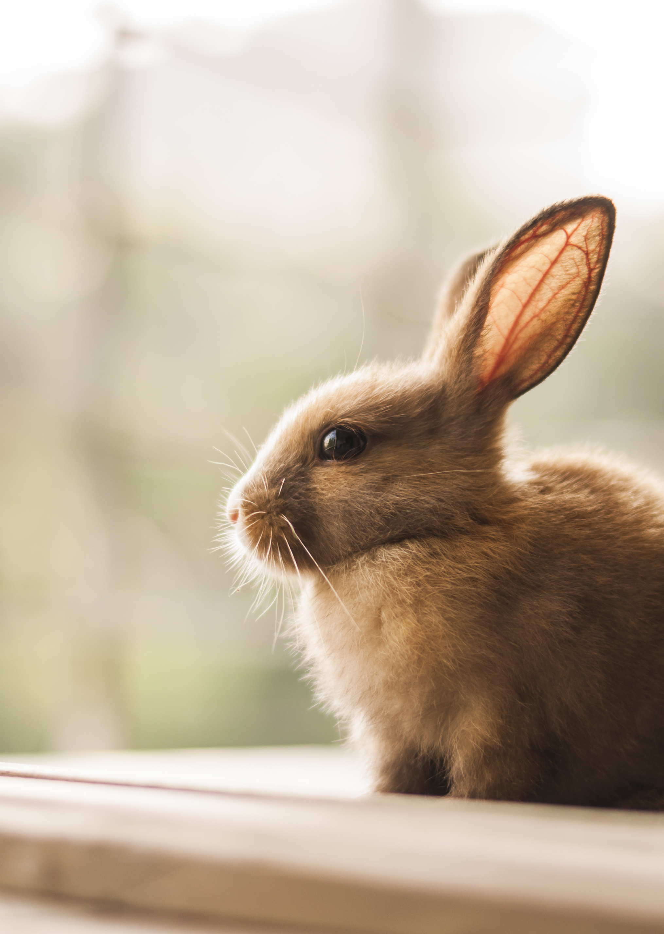
No rabbits in hats: linear regression in python
Becaause I already know the dataset is heteroscadastic, I am still going to do the same tests in python, just there will be no surprises in findings. No rabbits coming out of hats here.

Slide 14
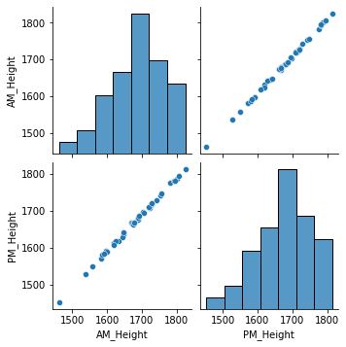
Testing for linearity in python
As with the linear test I did in R , python shows the same results. Once again I already know the homoscedasticity test is not going to fail but I am going to do it anyway.

Slide 15
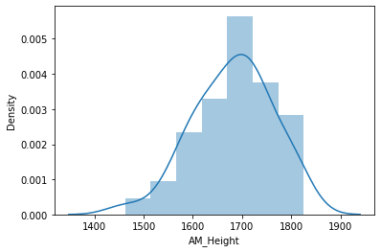
Show your curves(of distribution)
The histogram shows a curve that does show normal distribution here. That means how tall you are in the daytime directly affects how much you shrink at night.

Slide 16

Homoscedasticity test
Again, I already know this assumption is not going to pass but below are the results. No roll of the dice, just data.

Slide 17

Here is what happened
The scatter plot is somewhat skewed. I have also submitted my code so I will not be attaching the plot here. Next will be the results of the Breusch- Pagan test to test for homoscedasticity. (Pronounced “brush”)

Slide 18

Breusch- Pagan results Harvey collier results
(40.91347158491757,
nan, 18913.311446162563
3.855944268702337e-55)
The last # here is the p-value. As previously noted, this model is heteroscedastic . Although I already know transforming the data is not going to correct for the assumption I am going to do the test all the same. I also did a Harvey Collier test

Slide 19
Breusch- Pagan results Harvey collier results(cont.)T
Ttest_1sampResult(statistic=-0.0044761020277050233, pvalue=0.996452463756713
This means…still not going to pass the homoscedastic assumption. I am still going to do the data transformation with the boxcox that I did in R here in python.

Slide 20
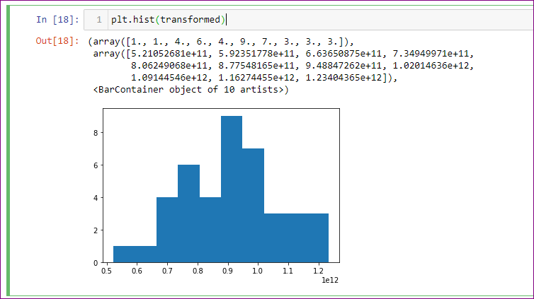

Slide 21

as shown, the data is still showing that it is not evenly distributed., but I am going to continue by making the new model
See attached code for result output.
the resulting figures result in a values that show a significant result already displayed. Although I don’t have multiple variables per se I will still do a multicollinearity test.

Slide 22
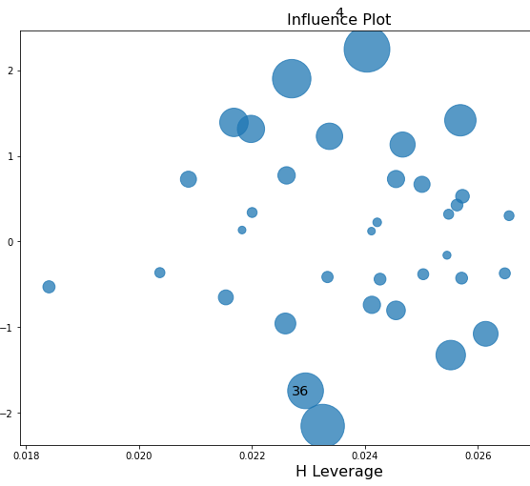
Way out lier
The outlier test shows that I have outliers. The larger circles are indicatos of outliers. The numbers are the outlier numbers annotated in a previous graph.

Slide 23

Final summary
As with the R results. The summary of the data shows there is significant effect on how much you shrink depending on how tall you started out. This is not and end all be all just an interpretation of the data that was used. It is entirely possible to get different results with different data.

